Slide 1
Predicting PM2.5
Carter Williams

Slide 2
Problem
Given daily data for various cities, predict tomorrow’s PM2.5 concentration.
Need to:
Filter and preprocess the data.
Fit the data into sequences with shape (# of days, # of features).
Incorporate data from neighboring cities.
Pass the sequences through a GRU and MLP to predict the next day’s PM2.5 concentration.

Slide 3
Preprocessing
Drop irrelevant columns.
Normalize the numerical columns using Z-score normalization.
Encode cyclical feature(s) (season) into sine and cosine values.
Whether month, day of year, or season was used, it did not matter.
Add the city’s next PM2.5 value to row. Drop rows that do not have that feature.
Incorporate closest K neighboring cities PM10 and PM2.5 values.
Multiplied by (1/distance(source, dest))
Fit into sequences of 10 days.

Slide 4
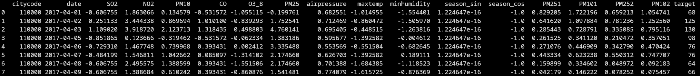
Data after Preprocessing
Fit cities new features into shape (# of data points, # of days, # of features).
In my case, used 10 days.
Can now batch data and feed through GRU.
Two neighboring cities used in this case.
Too many neighbors and/or neighboring features increased error.

Slide 5
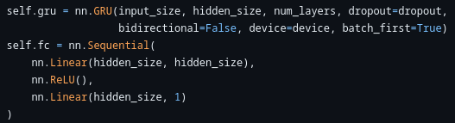
Model
GRU for sequences and MLP for predicting last output.
Hidden size: 128
GRU Layers: 2
Dropout: 0.2

Slide 6
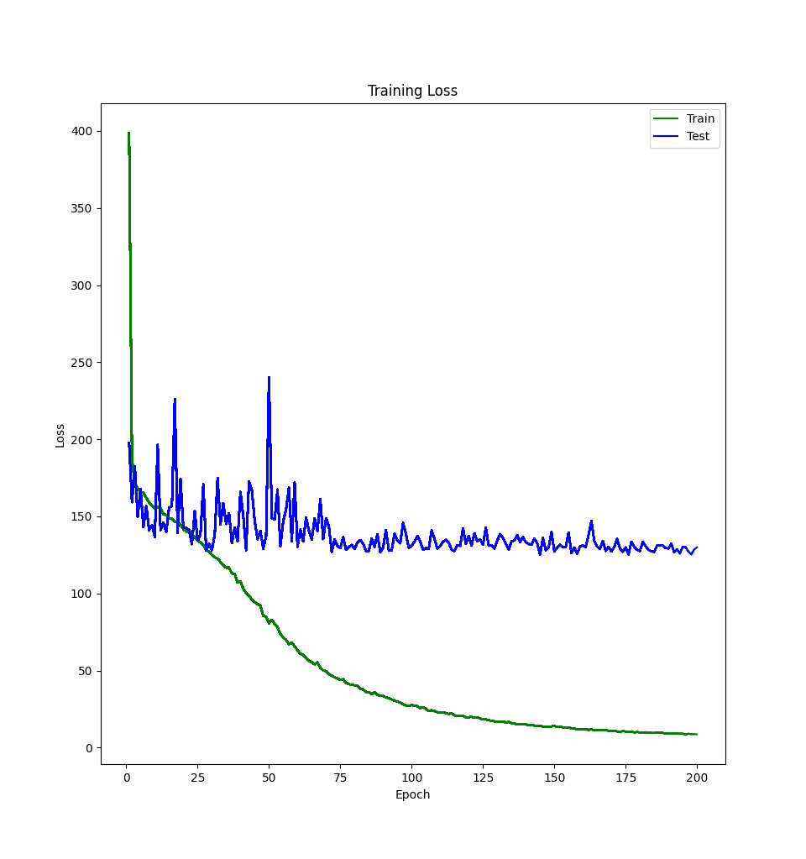
Training
Fed data in batches with shape (64, 10, d).
Used GRU’s last output as MLP input.
Receive output with shape (64, 1)
Predictions of target for last day in each batch.
Used MSE as the loss function.
~200 epochs
Found ~100 to be sufficient.

Slide 7
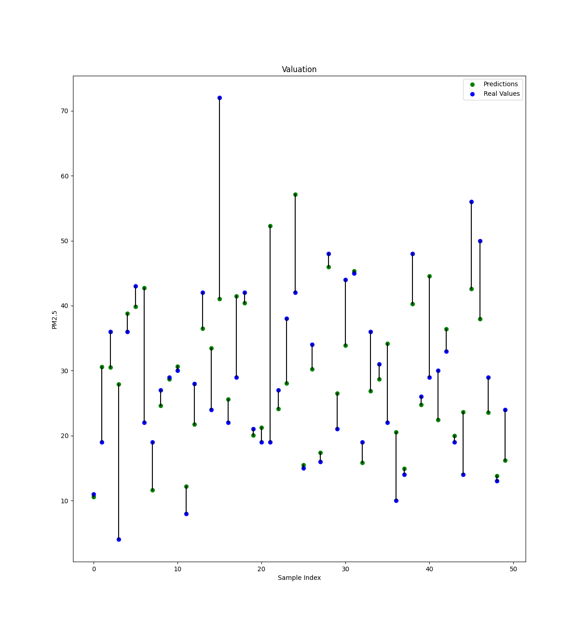
Performance
Validation MAE ~8
Validation MSE ~120

Slide 8
SHAP Values
Tried to use the shap.DeepExplainer from the package “shap” for this.
Ran into issues, so did not get SHAP values for features.

Slide 9
Alternative Solution
Initial idea was to use graph neural network to incorporate neighboring city features.
These new embeddings would then be passed through an RNN to predict the PM2.5 for the last day.
Has been successfully implemented to predict PM2.5 by others.
“PM2.5-GNN: A Domain Knowledge Enhanced Graph Neural Network For PM2.5 Forecasting”
My implementing gave erroneous output. This was likely caused by exploding gradients.
Would’ve needed more time to work out the solution’s issues.

Slide 10
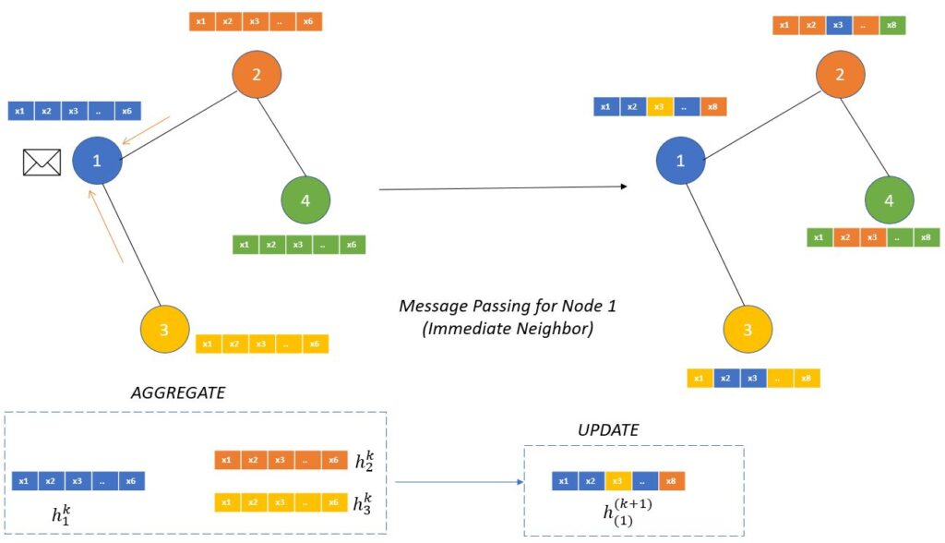
Alternative Solution Cont.
Create graph for each day.
Use GNN(s) to “share” node values.
Pass new sequential node embeddings through an RNN.
Get each city’s predicted value.

Slide 11
Demo

